Slide 1

E-Auction System
Presented by
Deepshikha
Harsh Prashad
Raixi Singh
Manish Saha
Karishma Rani Patro
Manjulika Sahoo
Guided by: Shailaja Patil

Slide 2

Index
Aim of the project
About E-auction
Objectives
Software Requirements
Flowchart
Implementation
Advantages
Limitations

Slide 3

Aim of the Project
To develop an E-Auction System using c programming.

Slide 4


About E-Auction
Auction:-
E-Auction:-

Slide 5




Objectives
Remove intermediaries/middlemen.
Provide market space to admin/seller.
Provide a space of online advertisement to business companies.
Reduce the workload of maintaining data.

Slide 6

Software Requirements
This E-Auction System is coded and made using the following:
Operating system: Linux
Software : Ubuntu
Back-end: C programming

Slide 7
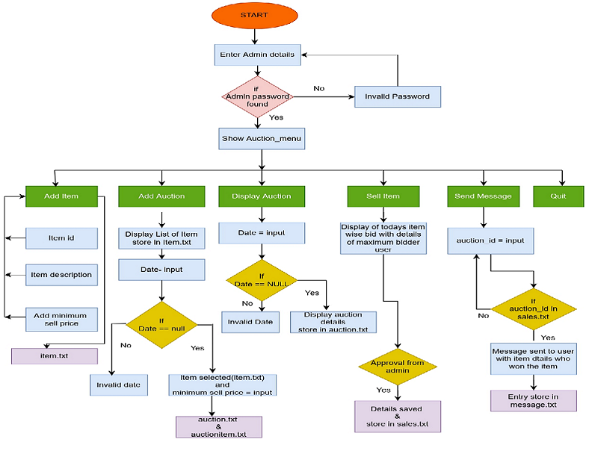
Flow chart of Admin

Slide 8
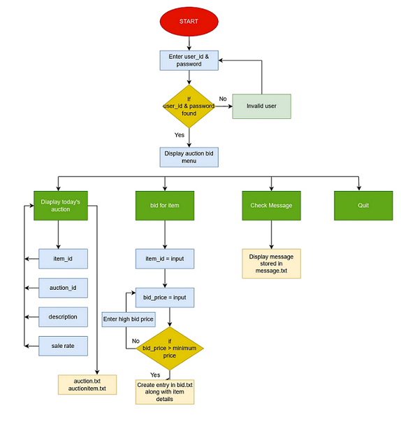
Flow chart of User

Slide 9
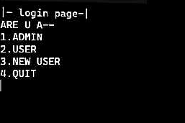
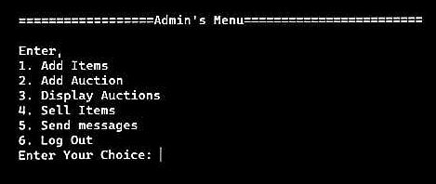
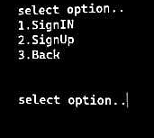
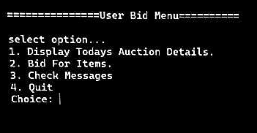
Implementation
After Execution the screen appears like this:

Slide 10
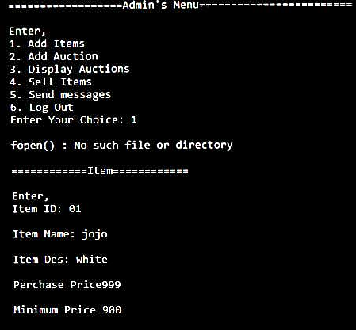
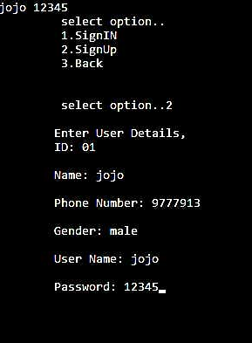
Implementation
After giving the input as per the requirement:

Slide 11

ADVANTAGES:
MORE CONVENIENT
LESS STRESSFUL
MORE COST EFFECTIVE
LARGER REACH
MORE BUYERS

Slide 12

LIMITATION:-
Security Risk Posed by Threat Vectors
Finding Suitable Reverse Auction Software
Price is Often the Major Driving Force

Slide 13


